Slide 1
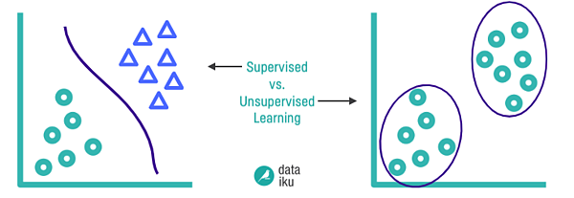
Machine Learning Clustering

Slide 2
CLUSTERING ALGORITHMS
Affinity Propagation
Mean Shift
Spectral Clustering
Dbscan
Optics
Birch

Slide 3
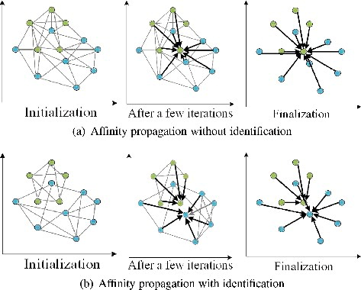
AFFINITY PROPAGATION
from sklearn.cluster import AffinityPropagation
aff = AffinityPropagation(random_state=5)
y_aff=aff.fit_predict(x)
Affinity Propagation is a clustering algorithm that groups data points based on message passing between them, identifying exemplars (cluster centers) and assigning other points to these exemplars.
Does not require the number of clusters (k) to be specified.
Works by passing messages between data points until a set of “exemplar” points and clusters emerge.

Slide 4
How It Works:
Every data point is considered a potential exemplar (cluster center).
Two types of messages are exchanged:
Responsibility (r(i, k)): How well-suited point k is to be the exemplar for point i.
Availability (a(i, k)): How appropriate it is for point i to choose point k as its exemplar.
Iteratively updates r and a until convergence.
Final cluster centers are chosen as exemplars.
Important Parameters:
preference: Controls how many exemplars are selected.
Higher → more clusters
Lower → fewer clusters
damping: Float between 0.5–1 to avoid numerical oscillations

Slide 5
PROS:
Automatic Cluster Number Determination: Affinity propagation doesn't require the user to predefine the number of clusters; it identifies the optimal number based on data characteristics.
Handles Varying Cluster Sizes and Densities: It can effectively cluster data with varying densities and sizes of clusters.
Suitable for Complex Data: It can be useful for datasets with complex relationships and non-linear structures where traditional methods might struggle.
Exploratory Data Analysis: Its ability to automatically determine the number of clusters makes it suitable for exploring datasets where the cluster structure is unknown.
Applications: It has been successfully applied in areas like image segmentation, gene expression analysis, and customer segmentation.

Slide 6
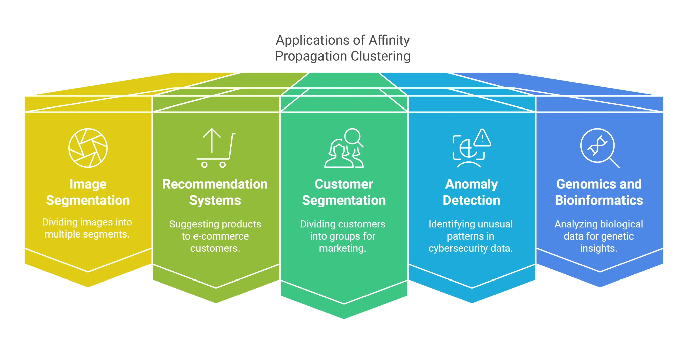
CONS:
Computational Complexity: Affinity propagation can be computationally expensive and memory-intensive, especially for large datasets, due to its quadratic time and space complexity.
Sensitivity to Similarity Metric: The choice of similarity metric can significantly impact the clustering results.
Interpretation Challenges: It can sometimes produce multiple exemplars for a single cluster, which can make the results harder to interpret.
Not Ideal for Large Datasets: The computational burden makes it less suitable for very large datasets.
Potential for Small Clusters: In some cases, it might produce a large number of small clusters.

Slide 7
MEAN SHIFT
from sklearn.cluster import MeanShift
MS = MeanShift(bandwidth=2).fit(x)
y_MS = MS.fit_predict(x)
Mean Shift is a centroid-based clustering algorithm that does not require you to specify the number of clusters. It works by shifting data points toward the highest density of points (the mode) iteratively, which is why it's called "mean shift".
How It Works:
Initialize a kernel (usually a Gaussian) around each data point.
Compute the mean of data points within the kernel (neighborhood).
Shift the center to the mean.
Repeat until convergence (no significant movement).
Points that converge to the same location form a cluster.

Slide 8
PROS:
Automatic Cluster Number Determination: Unlike K-Means, Mean Shift doesn't require specifying the number of clusters beforehand. It automatically identifies the number of clusters based on the data density.
Robust to Outliers: Mean Shift is relatively robust to outliers as they tend to get pushed away from denser clusters during the iterative process.
Handles Variable Cluster Shapes: Mean Shift can identify clusters of various shapes and sizes, unlike algorithms that assume spherical clusters.
No Need for Prior Shape Assumptions: It doesn't assume any specific shape for clusters (e.g., spherical, elliptical) and adapts to the data's natural distribution.
Simple to Implement: The core logic of Mean Shift is relatively straightforward, making it easy to understand and implement.

Slide 9
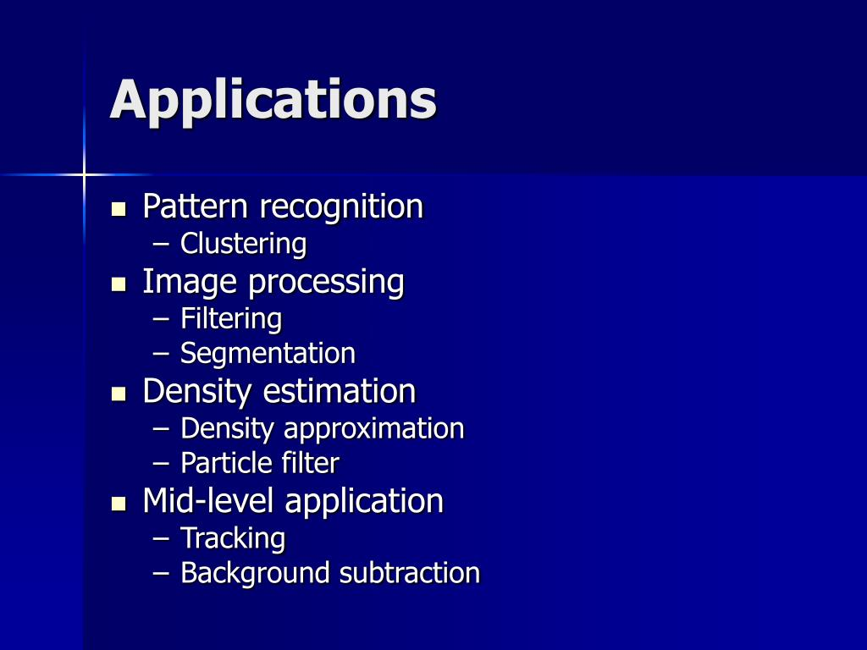
CONS:
Computational Complexity: Mean Shift can be computationally expensive, especially for large datasets, due to the iterative nature of the algorithm and the need for nearest neighbor searches.
Bandwidth Sensitivity: The bandwidth parameter (radius of the neighborhood) significantly impacts the clustering results. Selecting an appropriate bandwidth can be challenging and crucial for good performance.
Scalability Issues: Mean Shift doesn't scale well to high-dimensional data or very large datasets due to its computational complexity.
Dependence on Initialization: While each point starts as a cluster, the final cluster assignments can still be
influenced by the initial data distribution and the bandwidth.
Potential for Merging Clusters: If the bandwidth is too large, Mean Shift might merge distinct clusters into a single,
larger cluster.

Slide 10
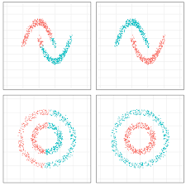
SPECTRAL CLUSTERING
from sklearn.cluster import SpectralClustering
SPC = SpectralClustering(n_clusters=2,assign_labels='discretize',random_state=0).fit(x)
y_MS = SPC.fit_predict(x)
Spectral Clustering is a powerful algorithm that uses concepts from graph theory and linear algebra. It's especially useful for finding non-convex clusters and complex shapes that algorithms like K-Means can't handle.
How It Works:
Construct a similarity graph: Represent data points as nodes; edges reflect similarity (e.g., using a Gaussian kernel).
Create the Laplacian matrix from this graph.
Compute the eigenvalues/eigenvectors of the Laplacian.
Use these eigenvectors to reduce the data dimensionality.
Apply K-Means on this reduced representation to form clusters.

Slide 11
Important Parameters:
n_clusters: Number of clusters
affinity:
'rbf': Gaussian kernel (default)
'nearest_neighbors': Good for graph-type data
assign_labels: 'kmeans' or 'discretize'
gamma: Used if affinity='rbf'

Slide 12
Pros:
Flexibility in Cluster Shape: Spectral clustering doesn't assume clusters are spherical or have a specific shape, making it suitable for complex, non-convex clusters.
Handles Non-Linear Data: It can effectively cluster data with non-linear boundaries, unlike algorithms like k-means that assume spherical clusters.
Robustness to Noise: Spectral clustering is generally less sensitive to noise and outliers compared to some other methods.
Can Discover Hidden Structures: By leveraging graph theory, it can reveal hidden relationships and structures within the data that might not be obvious with other methods.
Effective for Sparse Data: It can be computationally efficient for sparse datasets, particularly when dealing with a few thousand data points.
Dimensionality Reduction: It involves reducing the dimensionality of the data, which can simplify subsequent clustering steps.

Slide 13
CONS:
Computational Complexity: Calculating eigenvalues and eigenvectors for large datasets can be computationally expensive, potentially leading to slow performance.
Memory Intensive: Storing the similarity matrix (which can be dense) for large datasets can require significant memory.
Parameter Sensitivity: The choice of similarity matrix and other parameters can greatly affect the results, requiring careful tuning.
Scalability Issues: For extremely large datasets, spectral clustering can become impractical due to its computational complexity.
Post-processing Required: After the spectral decomposition, a separate clustering algorithm (like k-means) is typically used, which can introduce its own challenges.

Slide 14
When to Use:
Ideal for:
Non-linear cluster shapes (e.g., moons, circles)
Graph-based data
Small to medium datasets
Not ideal for:
Very large datasets (due to eigen decomposition)
When similarity matrix is hard to define
Applications:
Image segmentation
Community detection in networks
Recommendation systems
Voice or speech clustering

Slide 15
DBSCAN (Density-Based Spatial Clustering of Applications with Noise)
from sklearn.cluster import DBSCAN
DBS = DBSCAN(eps=3, min_samples=2).fit(x)
y_DBS = DBS.fit_predict(x)
DBSCAN is a popular density-based clustering algorithm. Unlike K-Means, it does not require specifying the number of clusters (k), and it's great at identifying arbitrarily shaped clusters and detecting noise/outliers.
DBSCAN doesn't require specifying the number of clusters beforehand and can handle clusters of arbitrary shapes and sizes. It's particularly useful for identifying clusters in datasets with varying densities and for outlier detection.
Core Concepts:
Core Points: A data point is a core point if it has at least a specified number of other data points (MinPts) within a given radius (epsilon or ε).
Border Points: A point that is within the ε radius of a core point but doesn't have enough neighbors itself to be a core point.
Noise Points: Points that are neither core points nor border points. They are isolated and don't belong to any cluster.

Slide 16
How It Works:
Two parameters:
eps: Maximum radius of the neighborhood.
min_samples: Minimum number of points in a neighborhood to form a dense region.
Classifies points as:
Core points: Have ≥ min_samples points within eps
Border points: Within eps of a core point but not a core point
Noise points: Not a core or border point
Connects core points to form clusters, adds border points, ignores noise.

Slide 17
PROS:
Handles arbitrary shapes: Unlike K-Means, DBSCAN can find clusters of any shape, not just spherical or convex.
Outlier detection: DBSCAN effectively identifies and marks outliers as noise.
No need to specify number of clusters: You don't need to know the number of clusters beforehand.
Robust to noise: DBSCAN can handle datasets with noise and outliers.
CONS:
Parameter sensitivity: DBSCAN is sensitive to the choice of ε and MinPts. The optimal parameters can be difficult to determine and may require trial and error.
Varying densities: DBSCAN may struggle with datasets where clusters have significantly different densities. An optimal ε for one cluster might not be appropriate for another.

Slide 18
Key Parameters:
Applications:
Customer segmentation
Anomaly detection (e.g. fraud)
Geospatial clustering
Image analysis (clustering pixels/objects)
Parameter | Description
eps | Radius for neighborhood (try 0.1 to 0.5)
min_samples | Minimum points to form a cluster (try 4–10)
metric | Distance metric (default: euclidean)

Slide 19
OPTICS (ORDERING POINTS TO IDENTIFY THE CLUSTERING STRUCTURE)
OPTICS is an advanced density-based clustering algorithm—an extension of DBSCAN—that can:
Discover clusters of varying density
Handle arbitrary cluster shapes
Identify noise and outliers
Work without needing a single global eps value
How It Works:
Computes reachability distance and core distance for each point.
Creates an ordering of points based on density-reachability.
Stores the structure in a reachability plot.
Clusters can be extracted from this plot manually or automatically (using xi parameter).
from sklearn.cluster import OPTICS
OPT = OPTICS(min_samples=2).fit(x)
y_OPT = OPT.fit_predict(x)

Slide 20
Key Parameters:
Applications:
Customer segmentation
Geospatial data clustering (e.g., earthquakes, crime spots)
Social network/community detection
Anomaly detection
Parameters | Description
min_samples | Minimum number of points in a cluster
xi | Determines steepness for cluster separation
min_cluster_size | Can be absolute number or fraction (e.g., 0.05)
metric | Distance metric (e.g., 'euclidean')
eps (optional) | Max radius to consider neighbors (default = inf)

Slide 21
PROS:
Handles varying densities: Unlike algorithms like DBSCAN that require a uniform epsilon (distance parameter), OPTICS can identify clusters with vastly different densities within the same dataset.
Detects noise and outliers: OPTICS effectively identifies data points that don't belong to any cluster, making it useful for outlier detection.
Hierarchical clustering structure: OPTICS produces a reachability plot that allows for visualizing the hierarchical structure of clusters, enabling analysis at different levels of granularity.
Flexibility: It doesn't require a predefined number of clusters and can identify clusters of various shapes and sizes.
Improved cluster extraction: The reachability plot allows for more informed cluster extraction, especially when dealing with complex datasets.

Slide 22
CONS:
High computational cost: OPTICS can be computationally expensive, especially on large datasets, due to the need to calculate reachability distances for all data points.
Parameter sensitivity: OPTICS is sensitive to parameter settings, such as the minPts (minimum number of points) and the distance metric, which can impact the quality of the clusters.
Requires dimensionality reduction: High-dimensional data can pose challenges for OPTICS, and dimensionality reduction techniques may be necessary to improve performance and interpretability.
Not as scalable as some other algorithms: Compared to some other clustering methods, OPTICS might not scale as well to extremely large datasets.

Slide 23
BIRCH (BALANCED ITERATIVE REDUCING AND CLUSTERING USING HIERARCHIES)
from sklearn.cluster import Birch
birc = Birch(n_clusters=None).fit(x)
y_birc = birc.fit_predict(x)
BIRCH is a hierarchical clustering algorithm specifically designed for large datasets. It's fast and memory-efficient because it builds a compact tree structure (called a CF tree) that summarizes the data.
How It Works:
Builds a CF Tree:
Each node (cluster feature or CF) stores summary info: number of points, linear sum, and square sum.
New points are inserted into the closest CF node.
Thresholding:
If a new point is too far from existing CFs (based on threshold), a new CF is created.
Keeps the tree balanced and within memory limits.
Final Clustering:
Optionally, K-Means or another clustering method is applied on the leaf nodes.

Slide 24
Key Parameters:
Applications:
Customer segmentation on large datasets
Real-time log/event stream clustering
Preprocessing for other clustering algorithms (like K-Means)
Parameter | Description
threshold | Max distance between points in a cluster (controls compactness)
branching_factor | Max children per node in CF tree (default = 50)
n_clusters | Final clustering method: None → returns leaf CFs as clusters Integer → applies K-Means on CFs

Slide 25
PROS:
Efficiency with Large Datasets: BIRCH excels at handling massive datasets by summarizing data points into a compact Cluster Feature (CF) tree, reducing memory usage.
Scalability: The algorithm scales well as the number of data points increases, making it suitable for big data applications.
Incremental Clustering: BIRCH can process data points one by one, making it suitable for real-time or streaming data analysis.
Outlier Handling: BIRCH can effectively handle outliers in the data.
No Need to Define K: Unlike some clustering algorithms, BIRCH does not require specifying the number of clusters (k) in advance.

Slide 26
CONS:
Sensitivity to Parameter Tuning: The performance of BIRCH can be affected by the choice of parameters like branching factor and threshold.
Limited to Spherical Clusters: BIRCH tends to produce spherical clusters, which may not be suitable for datasets with complex or non-spherical shapes.
High Dimensionality: BIRCH may struggle with datasets having a large number of features.
Data Ordering Dependence: The CF tree construction can be influenced by the order of data points, potentially impacting the clustering results.
Not Ideal for Uneven Cluster Sizes: BIRCH may not perform well when dealing with datasets where clusters have significantly different sizes.

Slide 27
Conclusion
Very useful in data mining
Applicable for both text and graphical based data
Help simplify data complexity
Classification
Detect hidden pattern in data

